Slide 1
RESTAURANT WEBSITE
Made By
Kavya Singh
181500319
Sec- J

Slide 2
Why this topic?
It is the front-end of BURGER KING Restaurant. Since everything is digitalized now a good online website is a must for big Restaurants. With this online website one can order food online though call, email or can even visit the Restaurant as the map is provided in our site. Feedbacks are also welcomed as every customer is valuable for us. This Restaurant website is completely based on HTML,CSS and JavaScript. The menu is shown in the site along with its prices. The main aim to build this website is to expand the business of the company all over the world. In these scenarios/ conditions of COVID -19 these sites are must for people as they are not visiting the restaurants and just ordering food online. So this website is the need of the hour
Notes:
To deploy it we have also used the git bash software

Slide 3
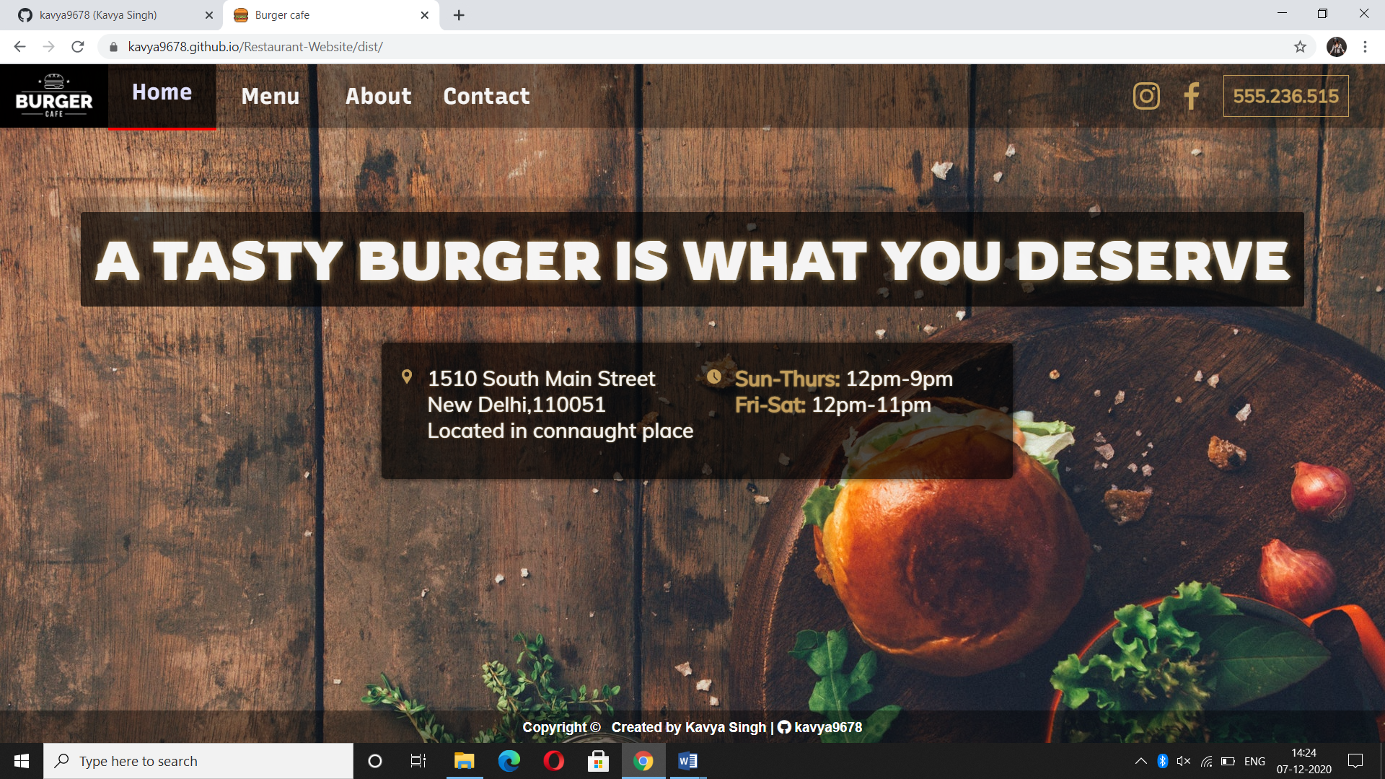
FRONT PAGE:

Slide 4
TECHNOLOGIES USED?
Software Interfaces:
a Front End: HTML, CSS, JavaScript
b Operating System: Windows 10
Hardware Interfaces:
a Processor: Intel CORE i5
b Hard Disk: 64 bits
c RAM: 8 GB

Slide 5
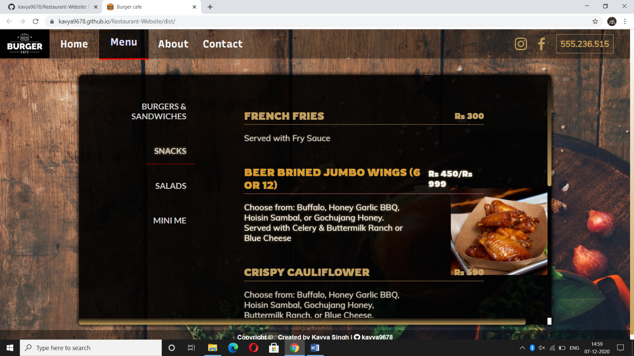
MENU PAGE:

Slide 6
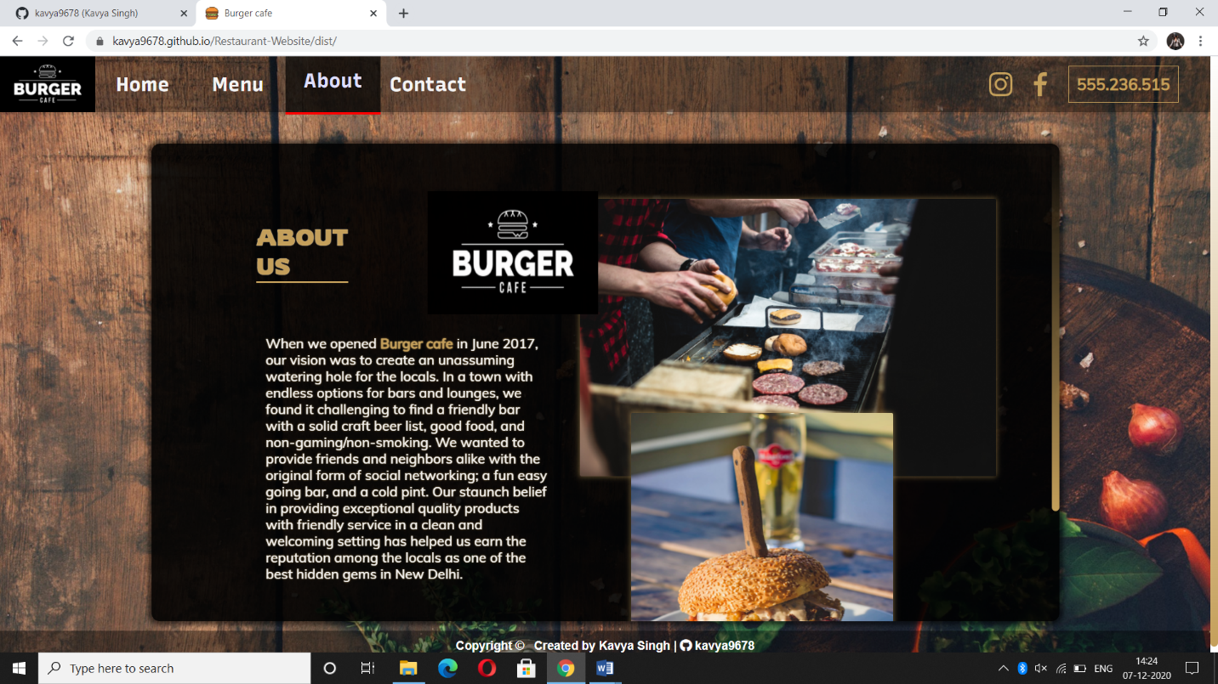
ABOUT PAGE:

Slide 7
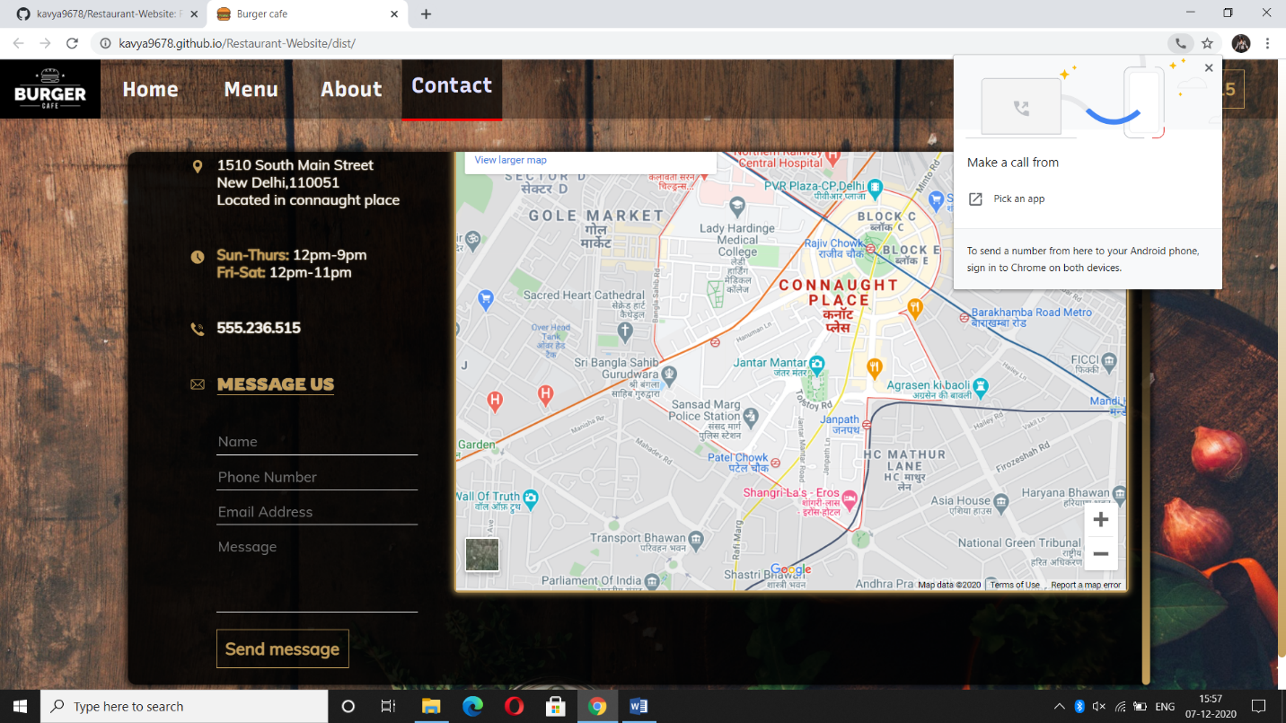
CONTACT PAGE:

Slide 8
CONCLUSION
The project entitled “RESTAURANT WEBSITE “has been proposed to be implementing to replace the manual system. The developed system accomplishes all the objectives stated for the need for the change of the system. The outputs produced seem to satisfy all the users but it will definitely take to look forwarded for the real consequences the new system could produce. This project was made user friendly. It’s also enabled the platform to serve the needs of emerging information technology trends and needs.

Slide 9
THANK
YOU

